Slide 1
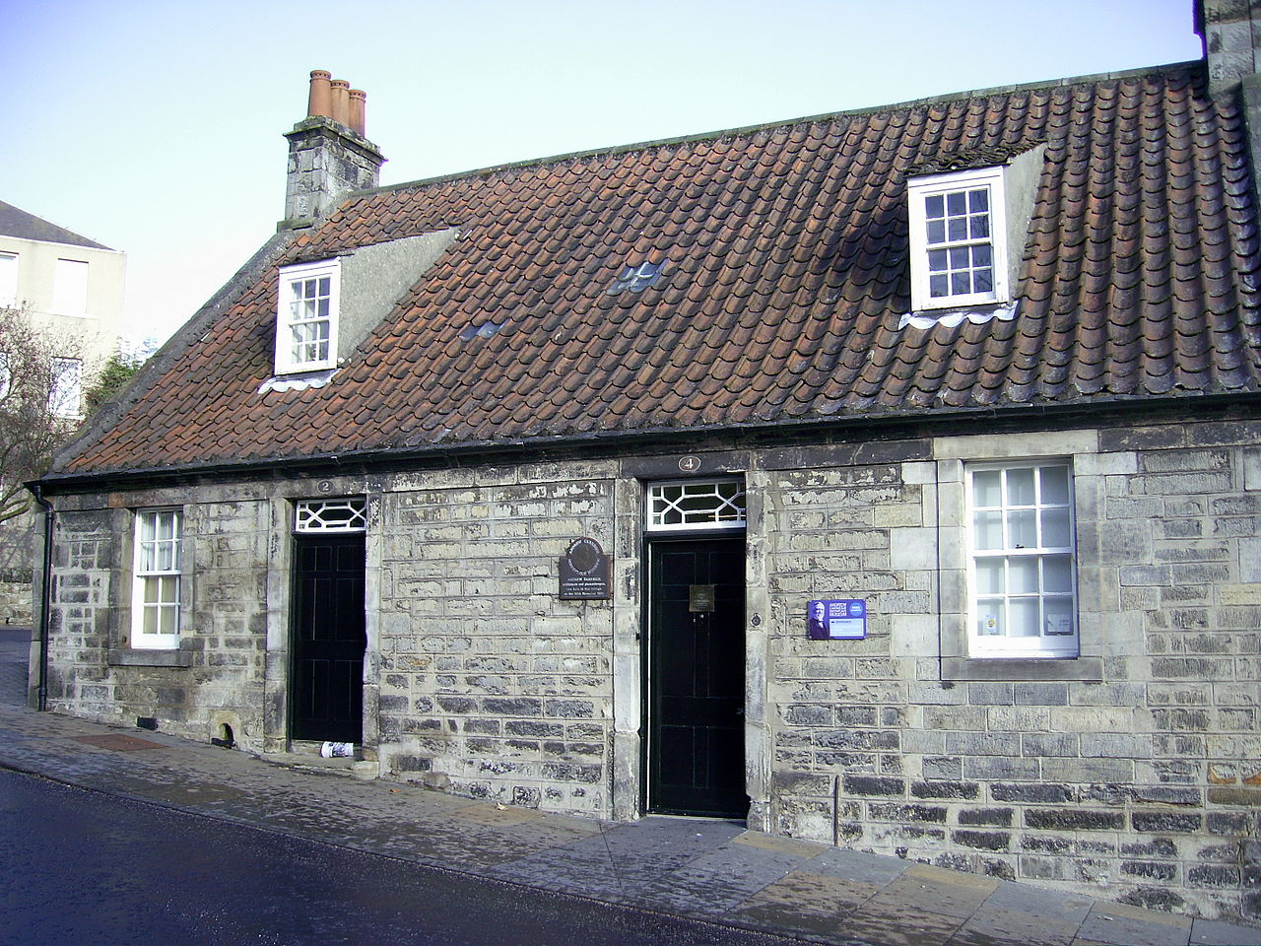
November 25, 1835
Dunfermline, Scotland

Slide 2
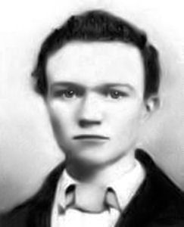
September 1848
Carnegie arrives in Allegheny City, PA

Slide 3
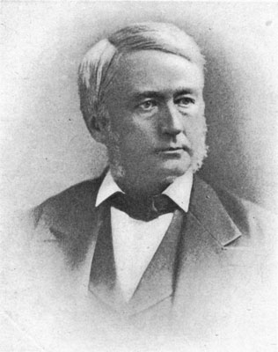
1849
Carnegie hired by
Thomas A. Scott as a “messenger boy”

Slide 4
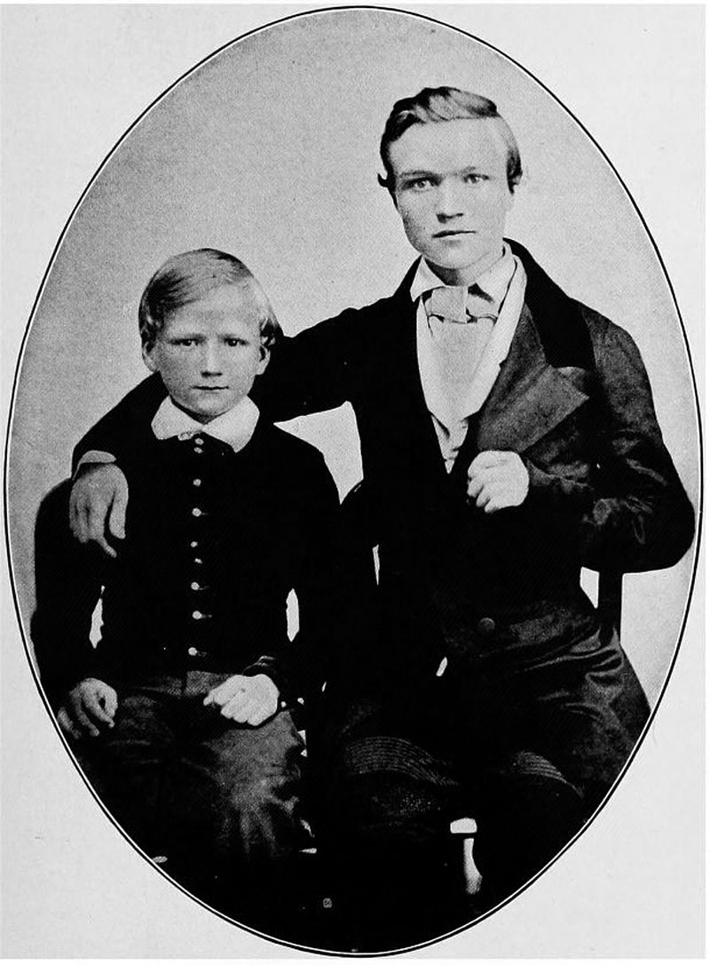
1853
Carnegie promoted to telegraph operator

Slide 5
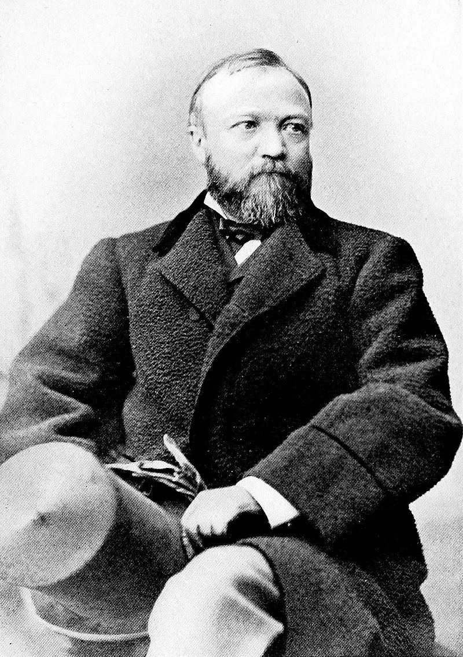
1855
First investment
1861-1865
Superintendent of the Military Railways and the Union government's telegraph lines

Slide 6
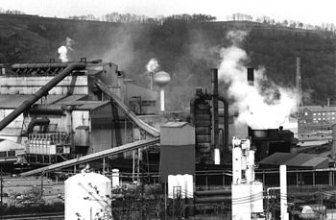
1872-1875
Carnegie Steel builds the Edgar Thomson Steel Works

Slide 7
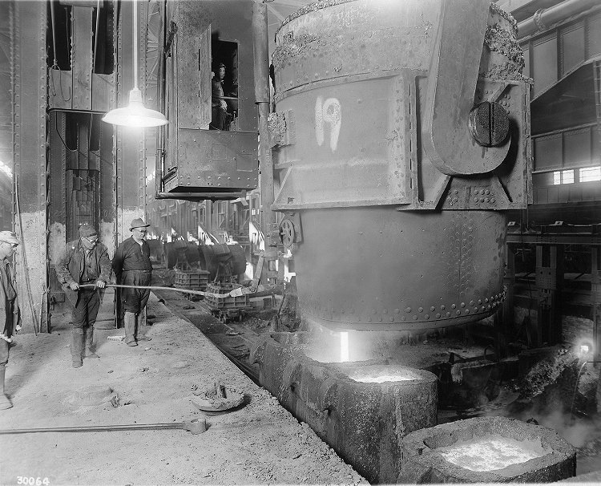
1883
Carnegie Steel purchases the Homestead Steel Works

Slide 8
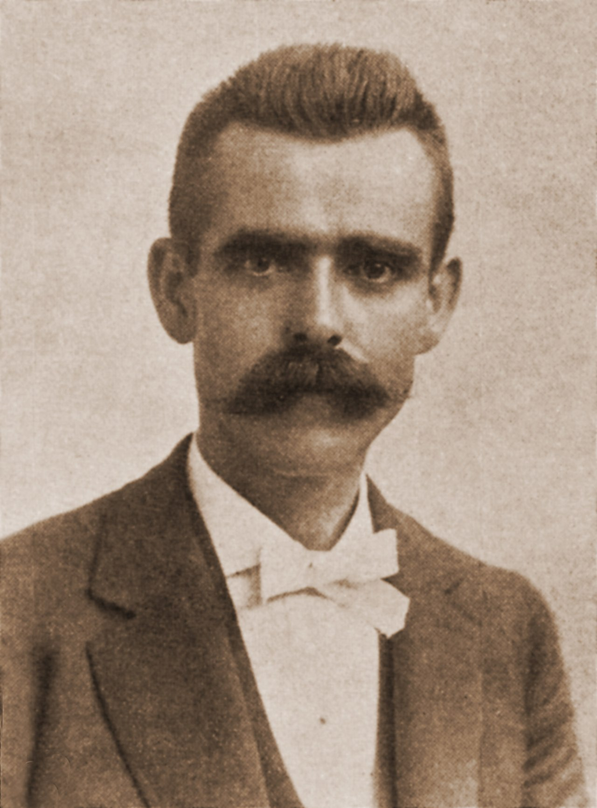
1889
Amalgamated Association (AAISW) at Homestead leads “victorious” strike effort

Slide 9
“Carnegie officials conceded that the AA essentially ran the Homestead plant after the 1889 strike. The union contract contained 58 pages of footnotes defining work-rules at the plant and strictly limited management's ability to maximize output.”
Brody, David. Steelworkers in America: The Nonunion Era. New York: Harper Torchbooks, 1969.
1889

Slide 10
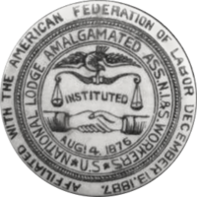
1889
AAISW at Homestead signs a three-year contract with the Carnegie company

Slide 11
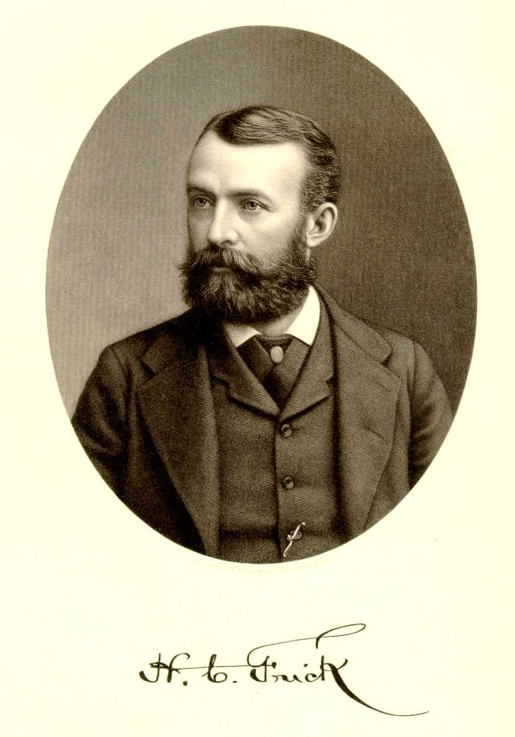
1889
Frick becomes president of Carnegie Steel

Slide 12
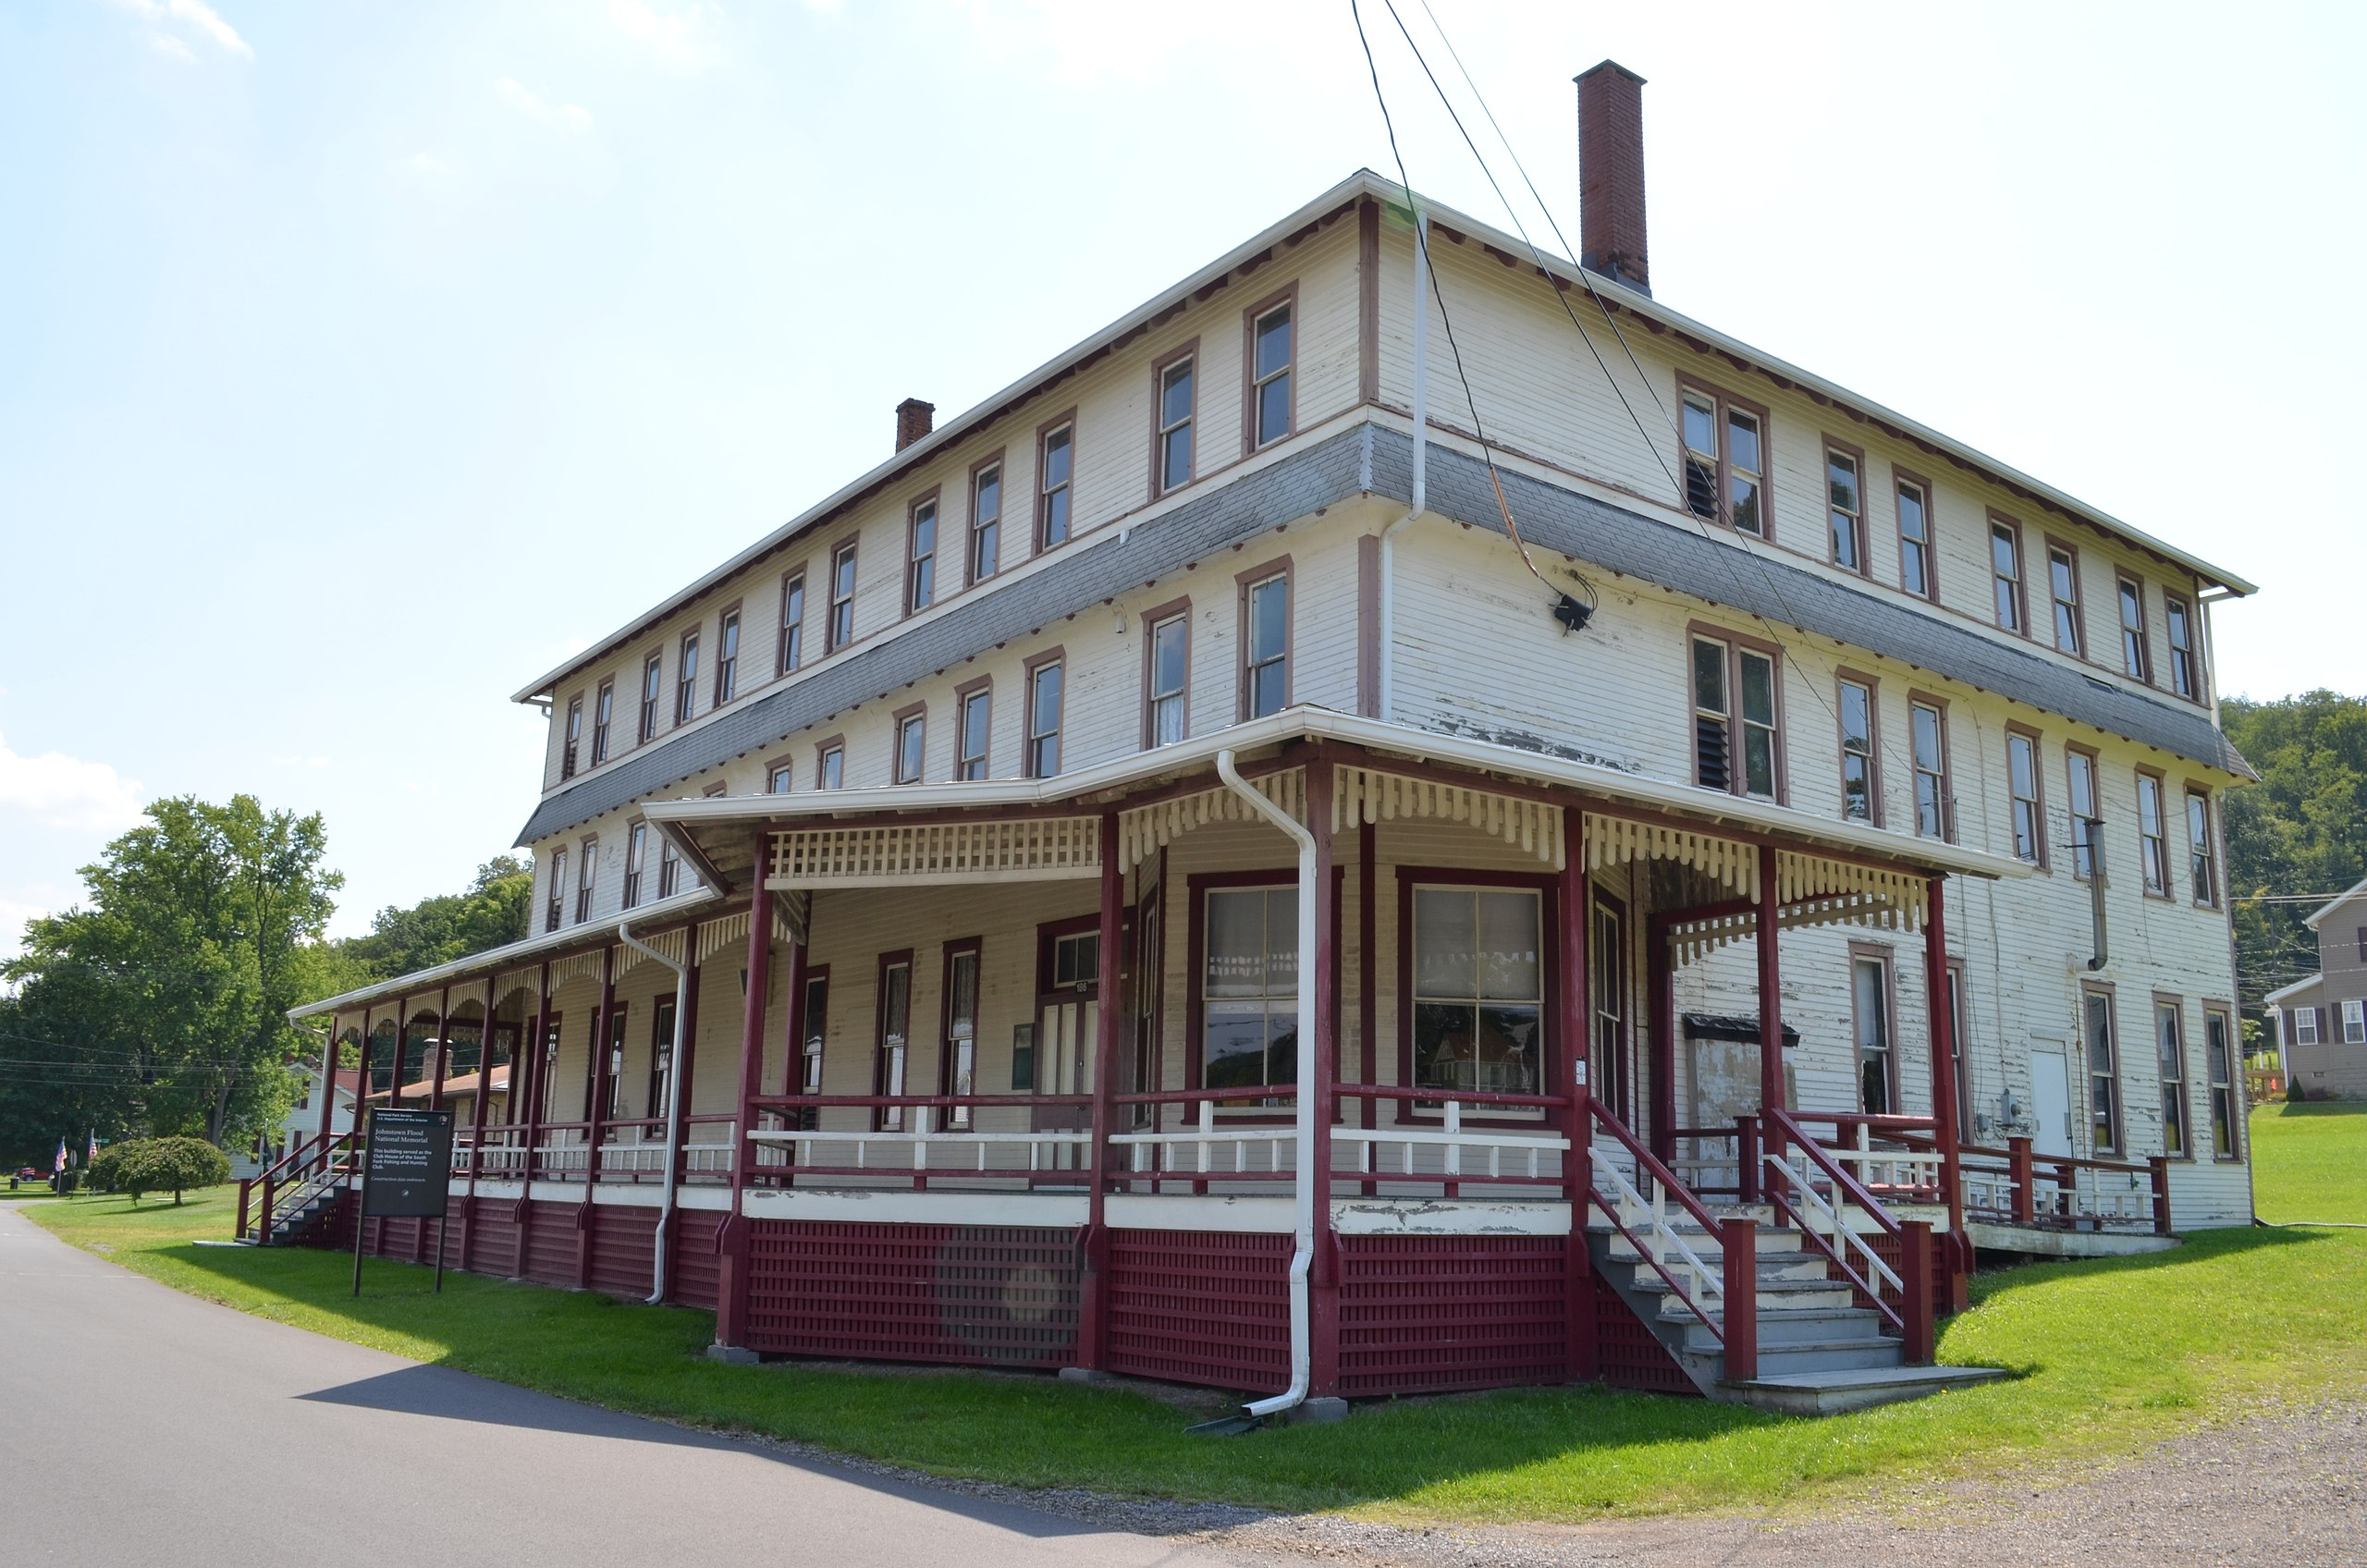
South Fork Hunting and Fishing Club

Slide 13
At issue:
The AAISW represented about 800 of the 3,800 workers at the plant.
AAISW asks for a wage increase
Frick counters with a 22% wage decrease that would affect nearly half the union's membership, and remove a number of positions from the bargaining unit.
February 1892
Negotiations begin on new AAISW contract

Slide 14
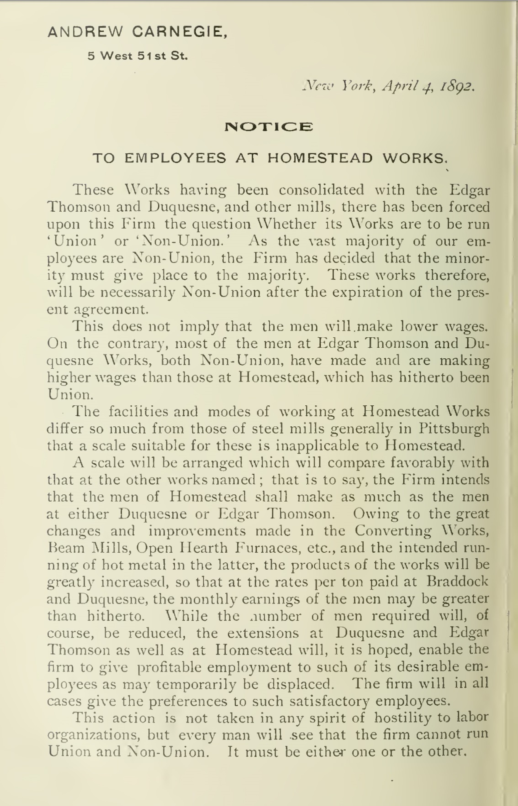
April 4, 1892
(exhibit 2)

Slide 15
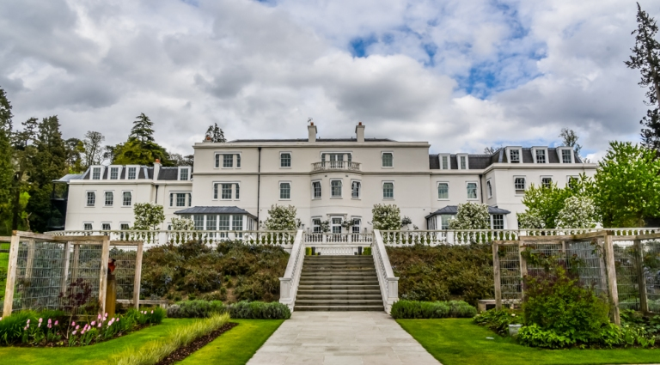
April 1892
Carnegie heads to Scotland for his annual holiday

Slide 16
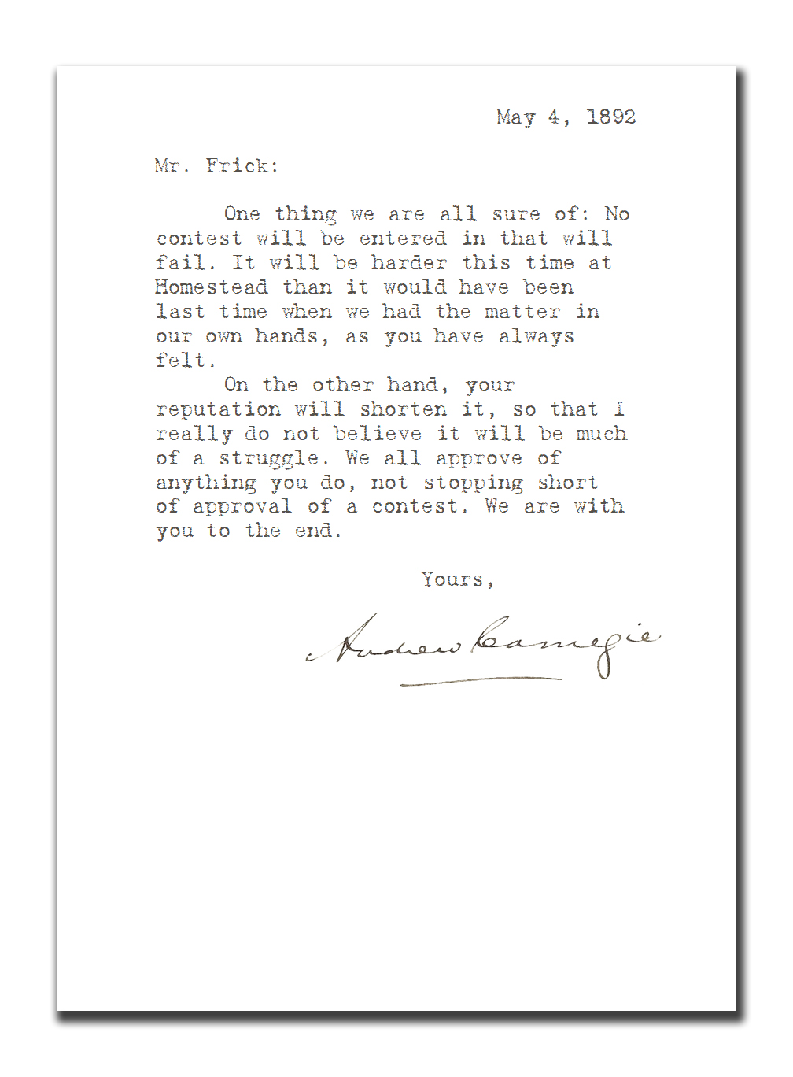
May 4, 1892
(exhibit 3)

Slide 17
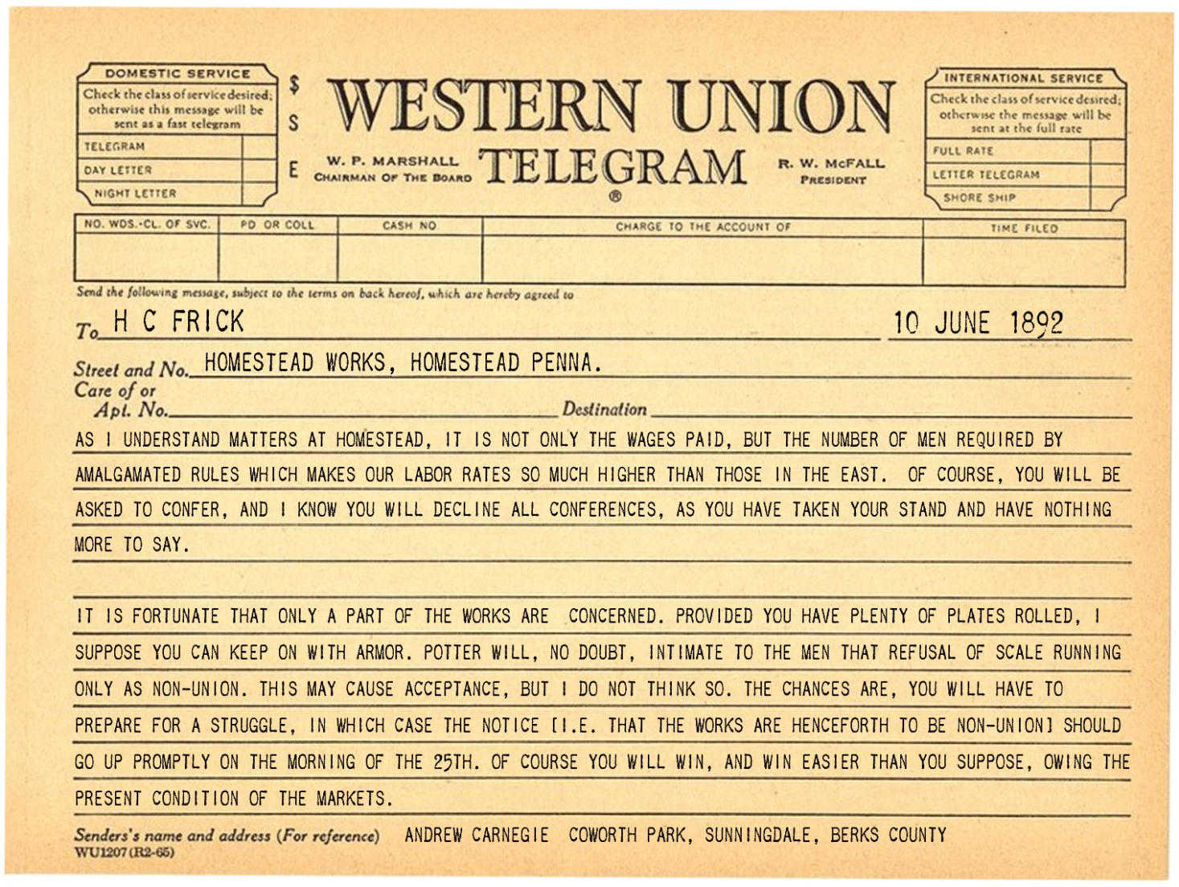
June 10, 1892
(exhibit 4)

Slide 18
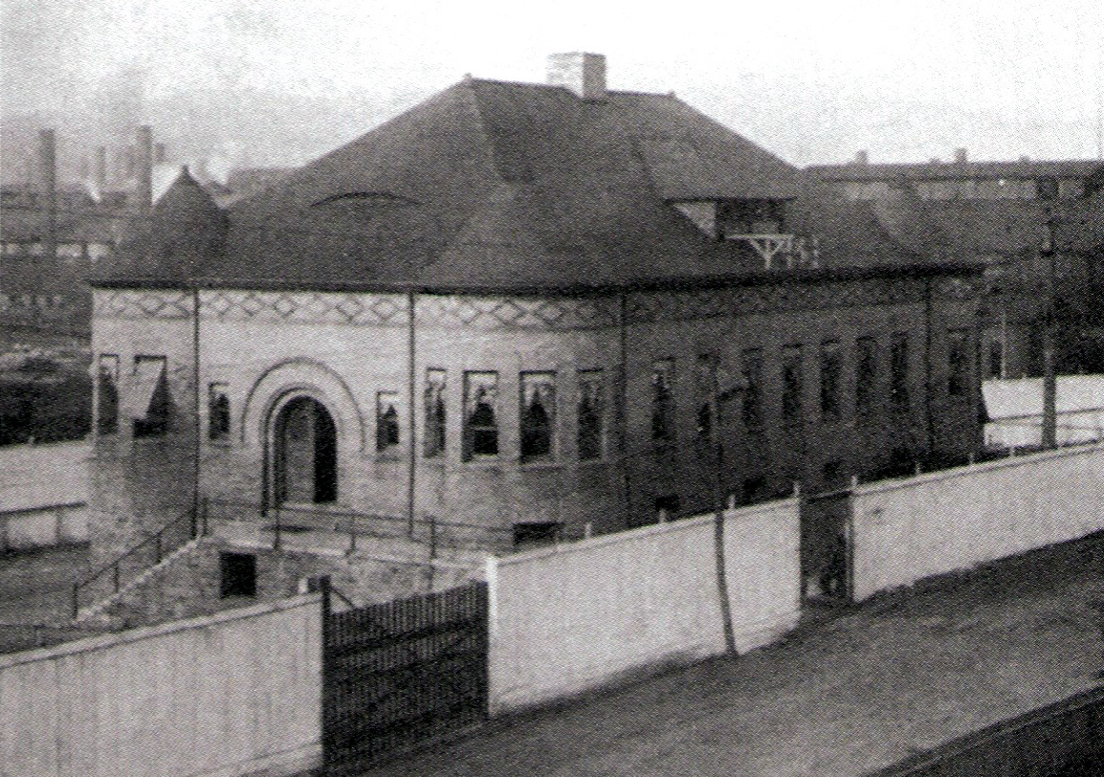
June 1892

Slide 19
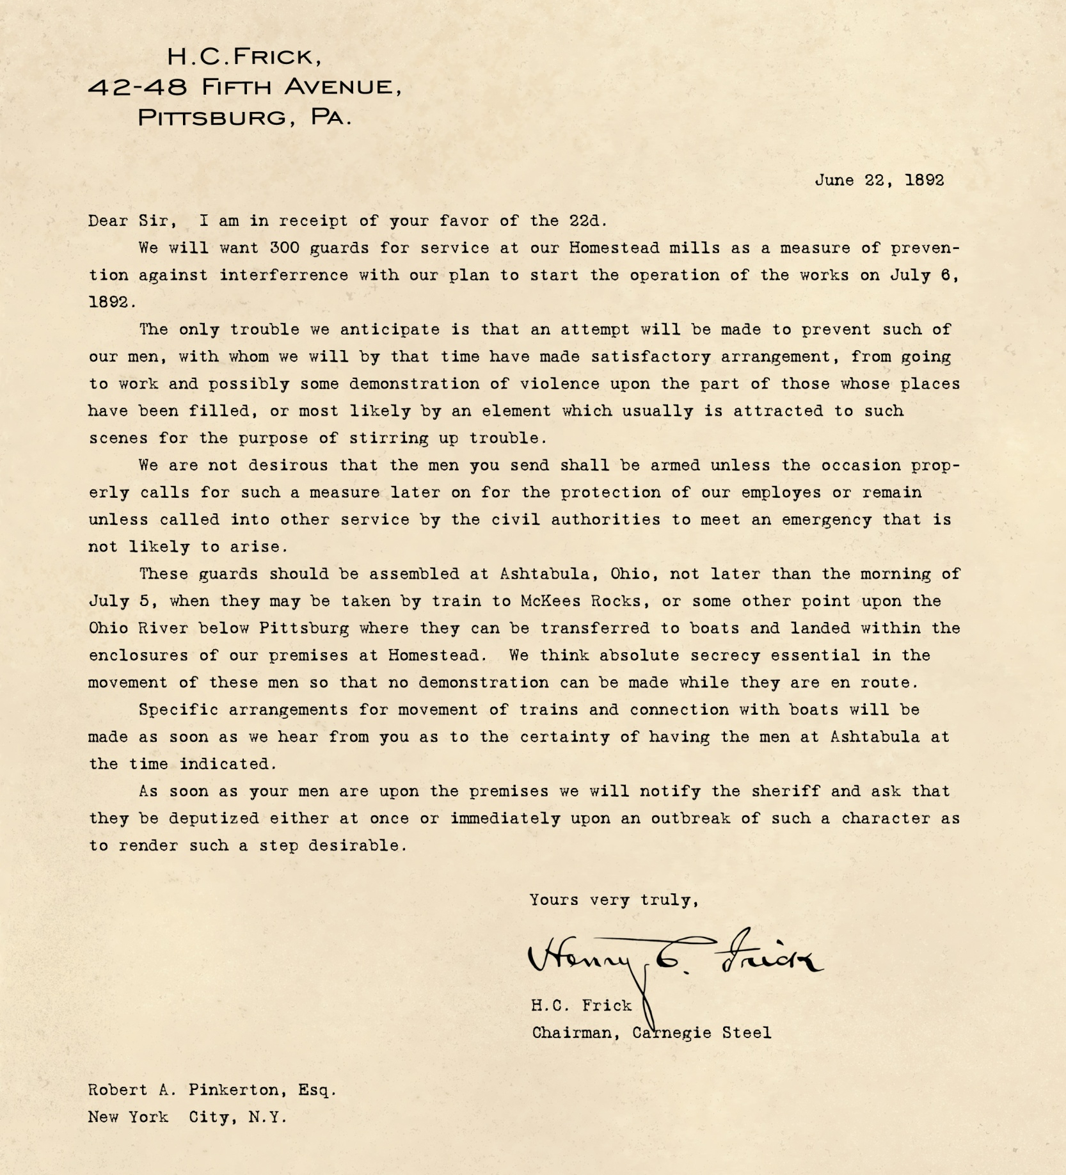
June 22, 1892
(exhibit 5)

Slide 20
June 28, 1892
Frick locks the workers out of the Homestead Works
June 30, 1892
AAISW’s contract with Carnegie Steel expires
July 1, 1892
Workers seize control of the Homestead Works

Slide 21
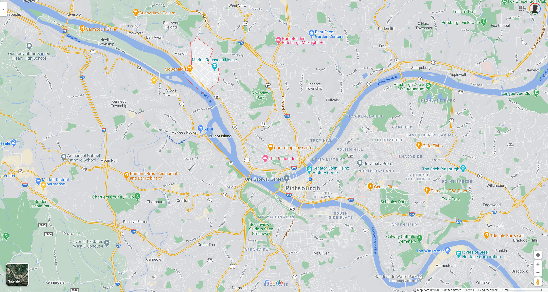
July 5, 1892 10:30 PM
300 Pinkertons arrive in Bellevue, assemble on Davis Island

Slide 22
July 6, 1892 2:20 AM
Pinkertons pass the Smithfield St. Bridge, alerting AAISW sentry

Slide 23
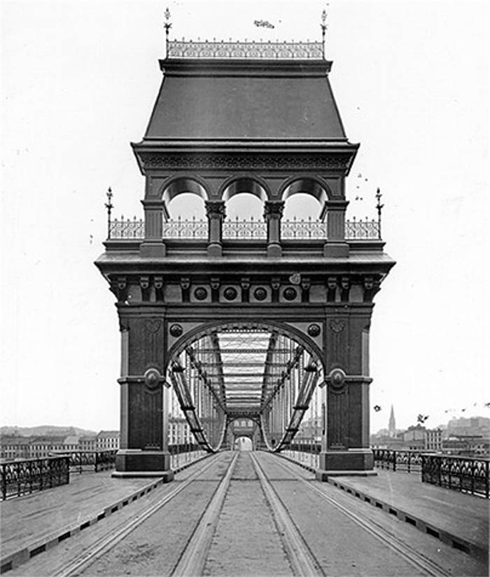
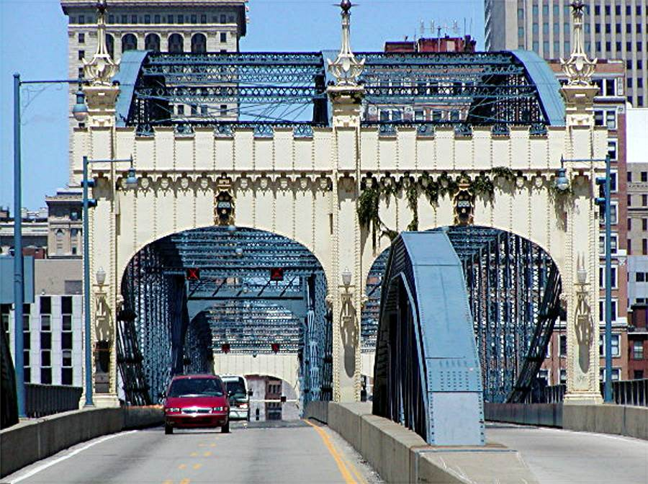
Smithfield Street Bridge

Slide 24
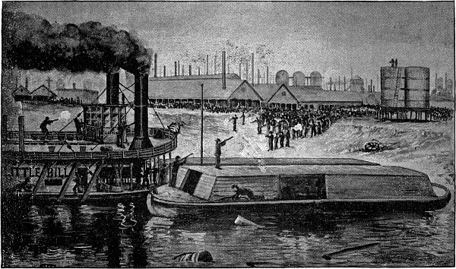
July 6, 1892 2:30 AM
Plant whistle blows at the Homestead Works

Slide 25
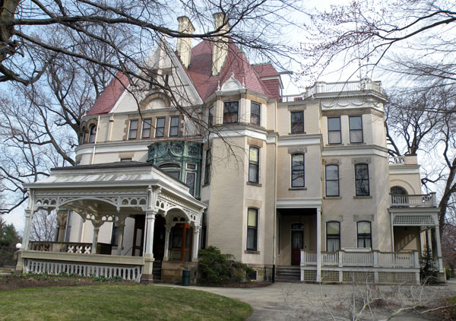
Clayton
Estate of Henry Clay Frick

