Slide 1
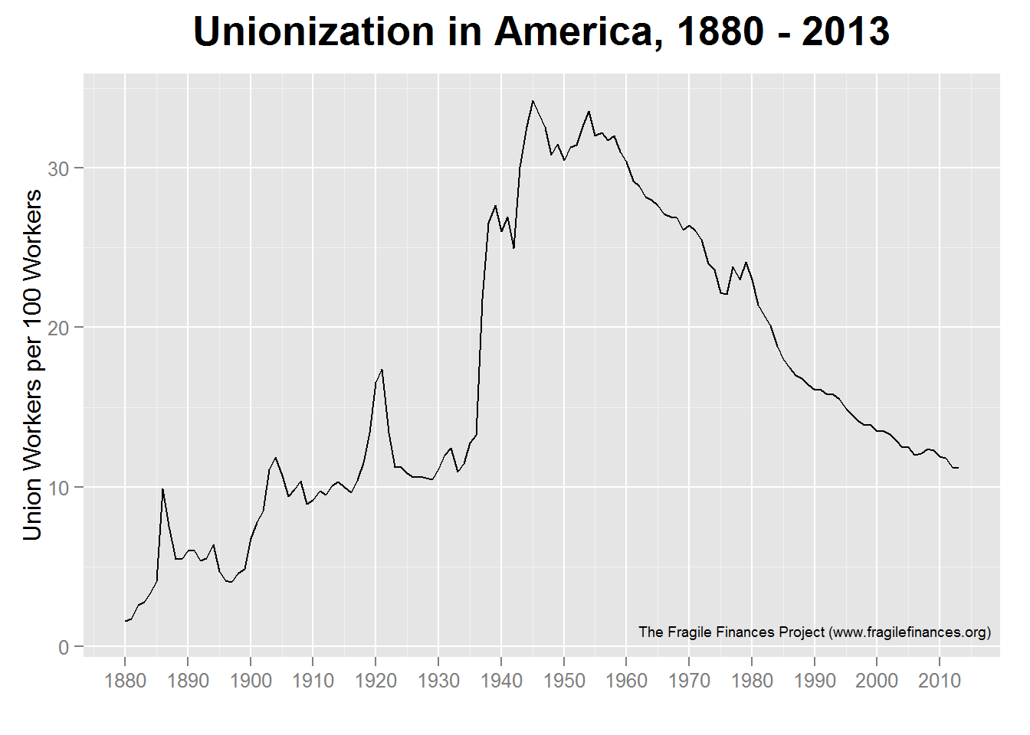
Steel Strike of 1959
Great Steel Strike
Taft-Hartley Act of 1948
Haymarket affair
PATCO strike
Homestead strike
National Labor Relations Act
Unemployment
in Beaver County reaches 27.1%
10.1%
(2023)
Pullman strike

